Slide 1
RUNTIME TERROR
Team:
Nick “Master of Pipe” Smith
Junru ”Master of None” Chen
David “Master of the Swing” Kwon
Tamarris ”Sound Master” Jenkins

Slide 2
How It Started
Text based survivor horror game
Good foundation (sounds and images)
Already established GUI
Good Game Logic

Slide 3
What We Wanted
Modular code
More Interactive
Outside source for word parser
Better understanding of location
Weapons
Ability to fight

Slide 4
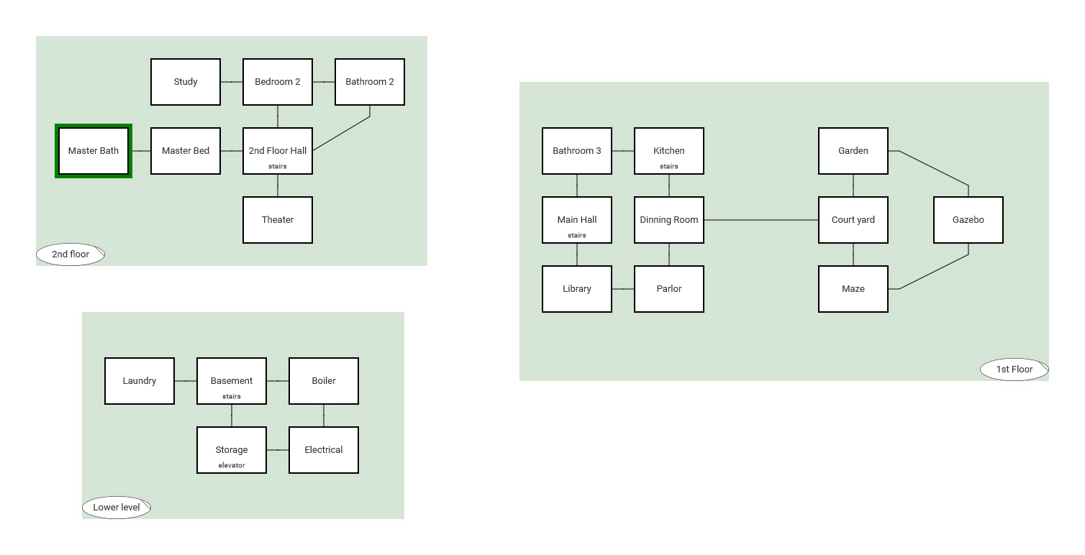
Learnings and Challenges

Slide 5
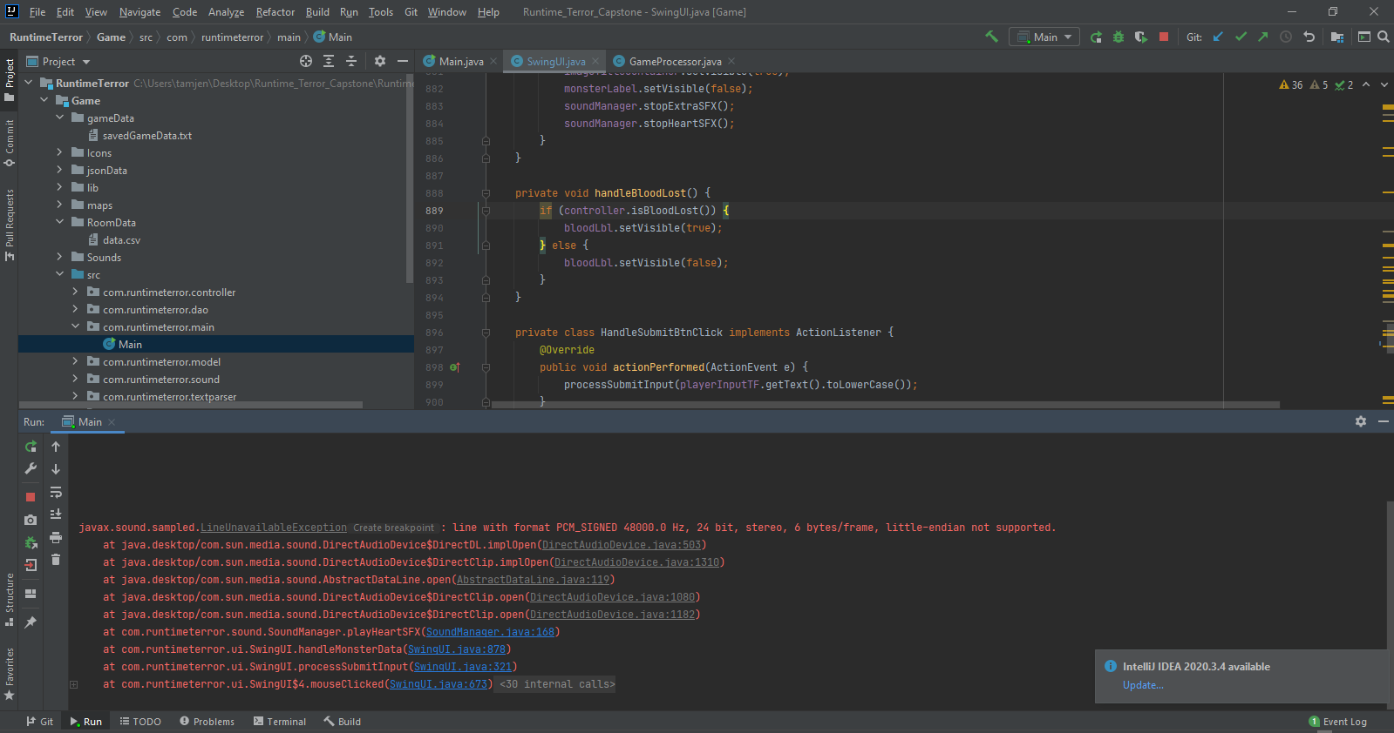
Learnings and Challenges

Slide 6
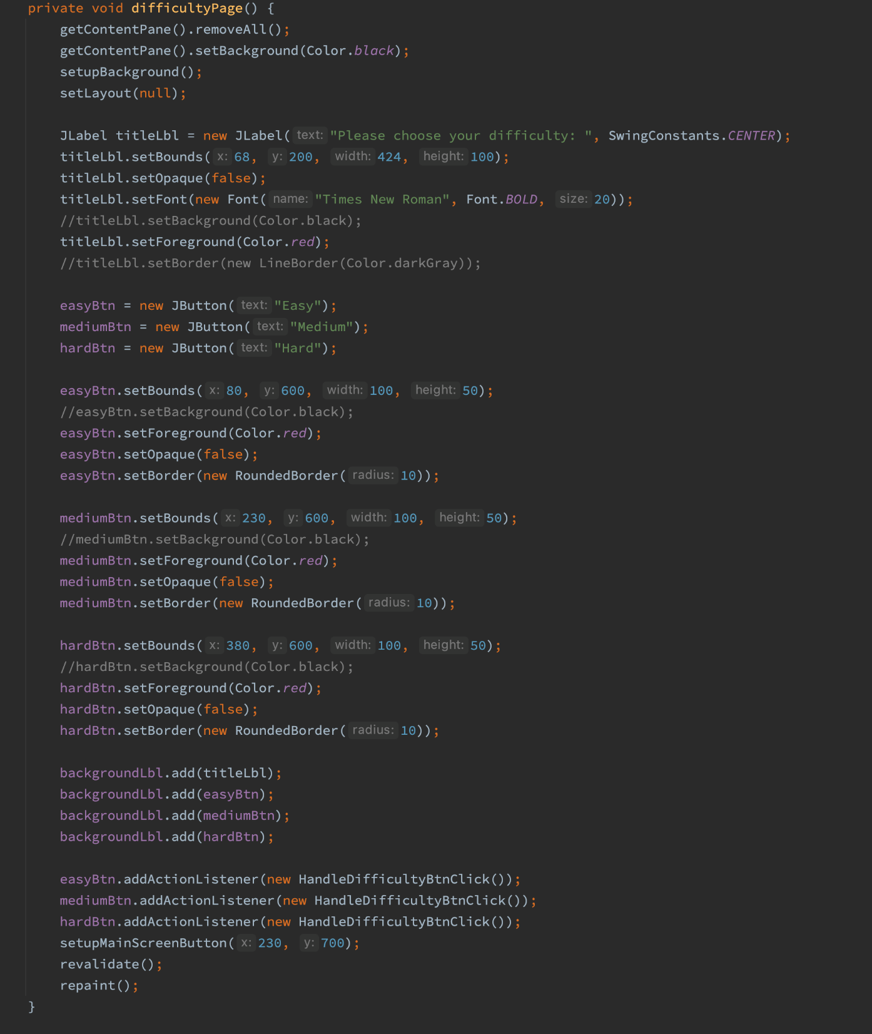
Learnings and Challenges

Slide 7
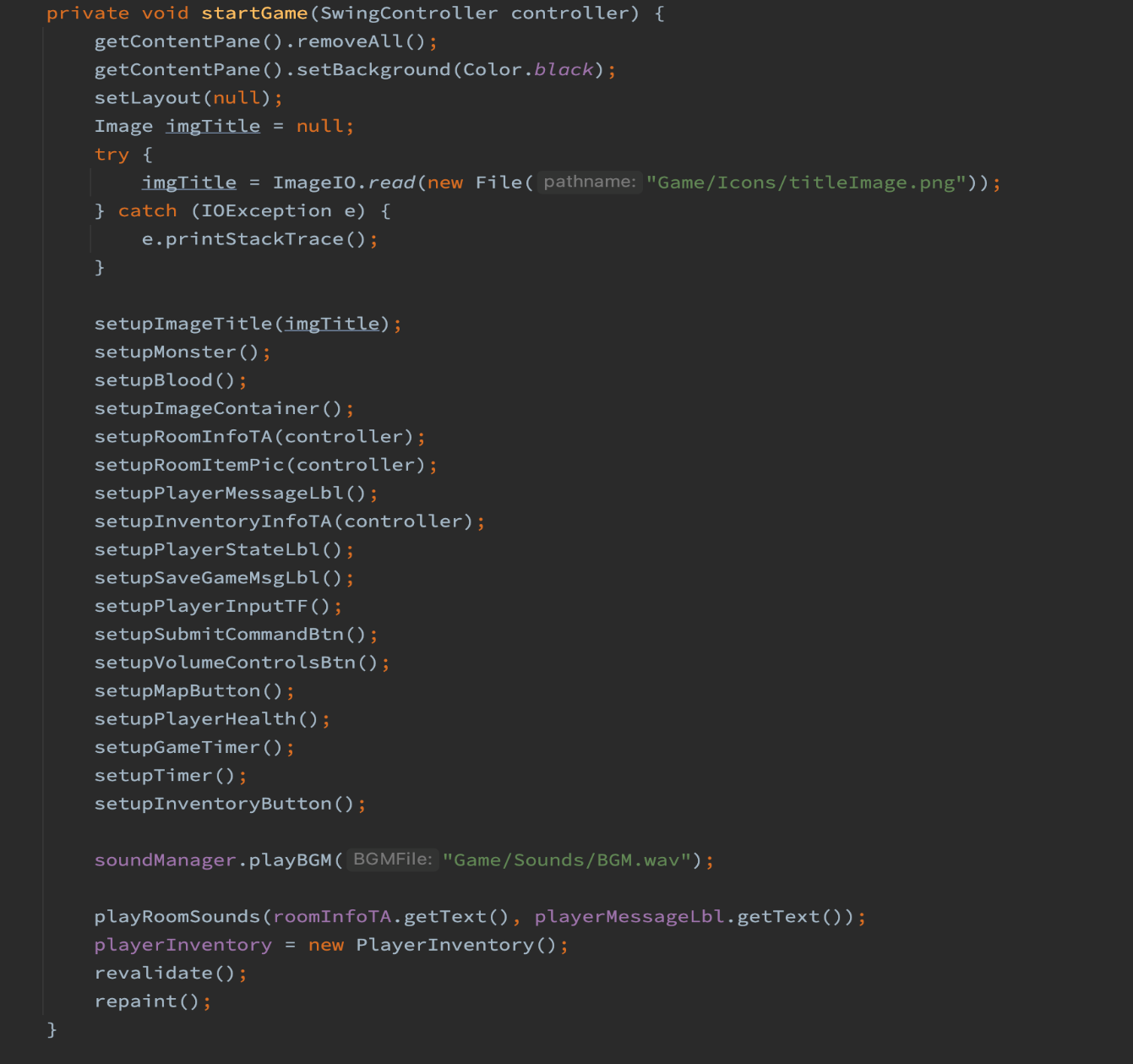
Learnings and Challenges

Slide 8
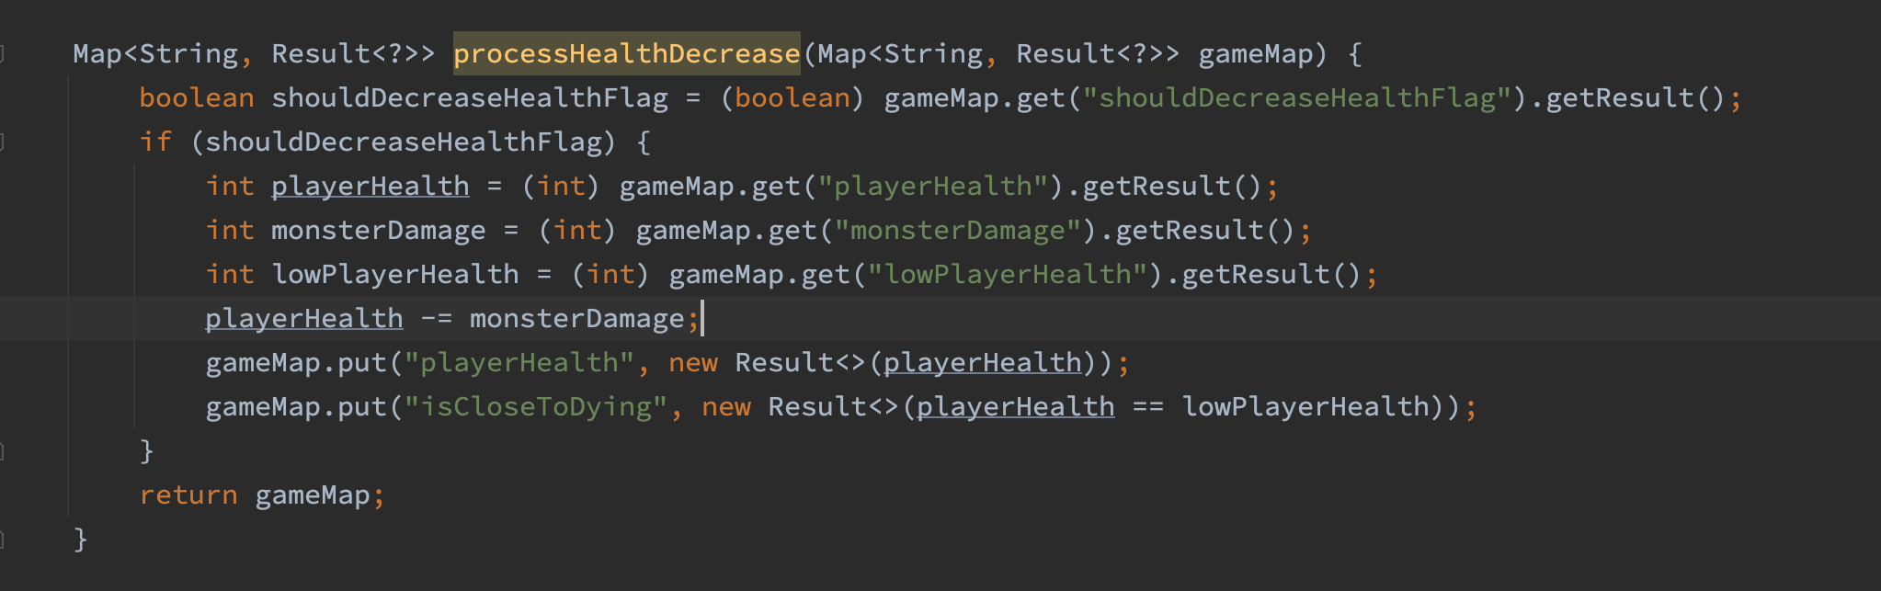
Learnings and Challenges

Slide 9
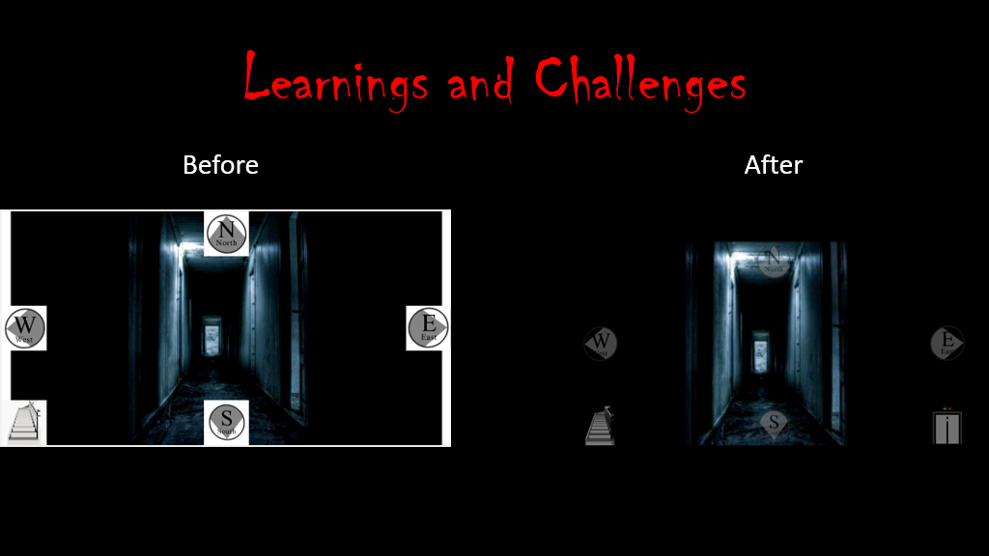
Learnings and Challenges

Slide 10
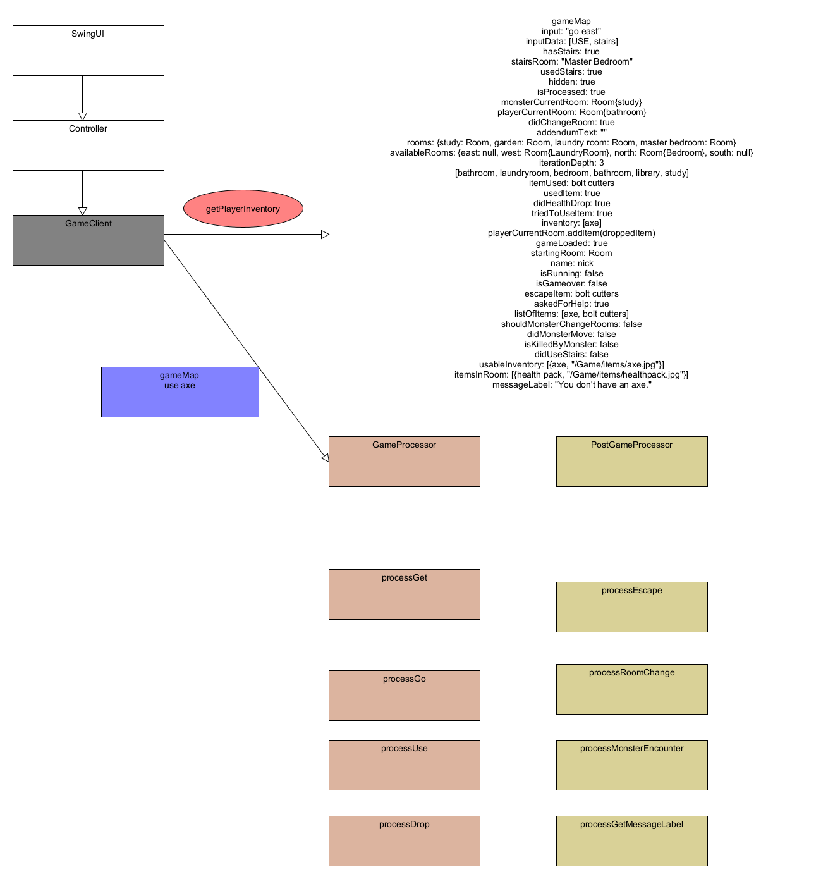

Slide 11
Data
ProcessGo
Drop axe
ProcessGet
ProcessUse
ProcessStairs

Slide 12
ProcessDrop
ProcessGo
ProcessGet
ProcessUse
ProcessStairs

Slide 13
Data
ProcessGo
Drop axe
ProcessGet
ProcessUse
ProcessStairs
ProcessDrop

Slide 14


Slide 15

ProcessGo
ProcessGet
ProcessUse
ProcessStairs
ProcessDrop

Slide 16
ProcessGo
Ruby
ProcessGet
Ruby
ProcessUse
Python
ProcessStairs
JavaScript
ProcessDrop
Ruby

Slide 17
Game Highlights
Swing
DynamoDB
S3
Design
Website
JSON

Slide 18
Demo

Slide 19
What’s Next?
Move on from text all together
Use other AWS services(Lambda)
React Front-end http://runtimeterrorreact.s3-website.us-east-2.amazonaws.com/
Create customized game
Larger screen with dialog in picture
Cross platform

Slide 20

Questions

